Slide 1

From Pixels to Intelligence
Building Geospatial AI on Google Cloud
Ajeyomi Adedoyin Samuel
SammyGIS
Geospatial Data Scientist · sammygis.github.io
Notes:
Open: every day, satellites photograph all of Nigeria. Those are just pixels. Today I'll show how Google Cloud turns those pixels into decisions — on forests, farms, floods, soil and health — with five use cases, real organisations already doing it, and what I've built along the way.

Slide 2





About the Speaker
Ajeyomi Adedoyin Samuel · SammyGIS
Geospatial data scientist and data engineer. I turn satellite data into tools people can actually use.
What I do
Skills I work with
What interests me
What I love
Data engineering and backend: geospatial data pipelines, APIs and GeoAI models for climate risk, agriculture, land and health.
Earth Engine · Python (rasterio, pandas) · BigQuery and Google Cloud · Airflow and Terraform · Django and PostGIS
Research and asking questions. Multi-hazard climate risk, SAR and optical data fusion, soil carbon, and GeoAI for Sub-Saharan Africa.
Research, asking questions and sharing with the community. Off the laptop: listening to music and watching movies — especially historical ones.

Slide 3
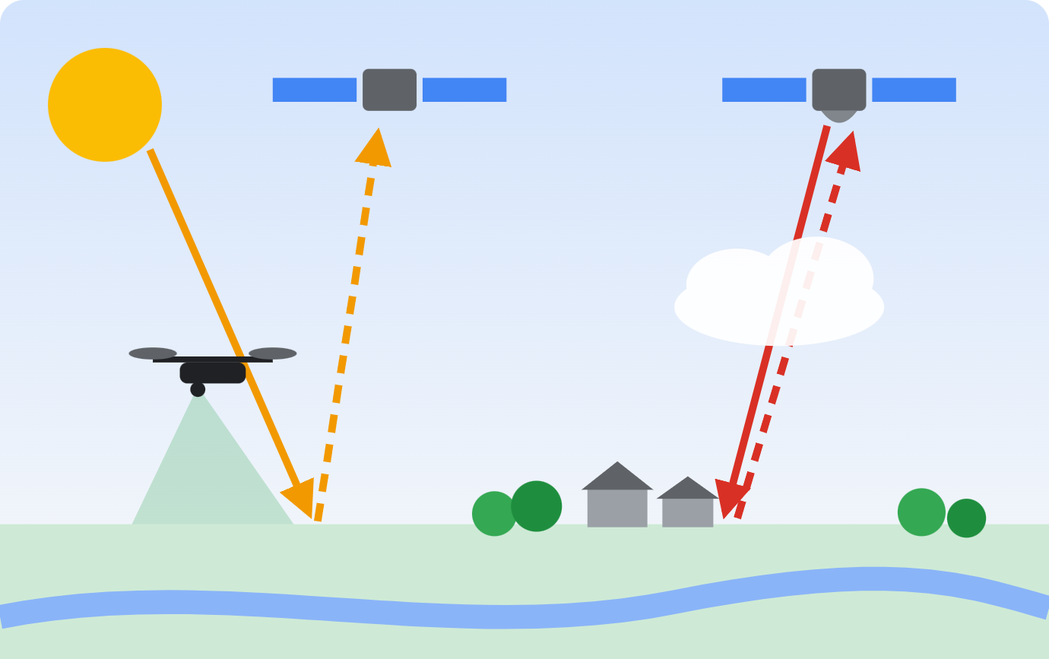
Remote Sensing: Measuring Earth from Above
Flooding
Heat risk
Rainfall & drought
Sentinel-1 SAR, JRC Surface Water
Landsat thermal, MODIS land temperature
CHIRPS daily rainfall, ERA5-Land climate
Agriculture
Forests
Urban growth
Sentinel-2 NDVI, AlphaEarth embeddings
Hansen Global Forest Change
Open Buildings, Dynamic World land cover
Passive satellite — reflected sunlight
Active radar — through cloud, day and night
Air quality
Health access
Soil & terrain
Drone — flies low, centimetre detail
Sentinel-5P NO₂ and aerosols
WorldPop population, Open Buildings
SoilGrids, SRTM elevation

Slide 4
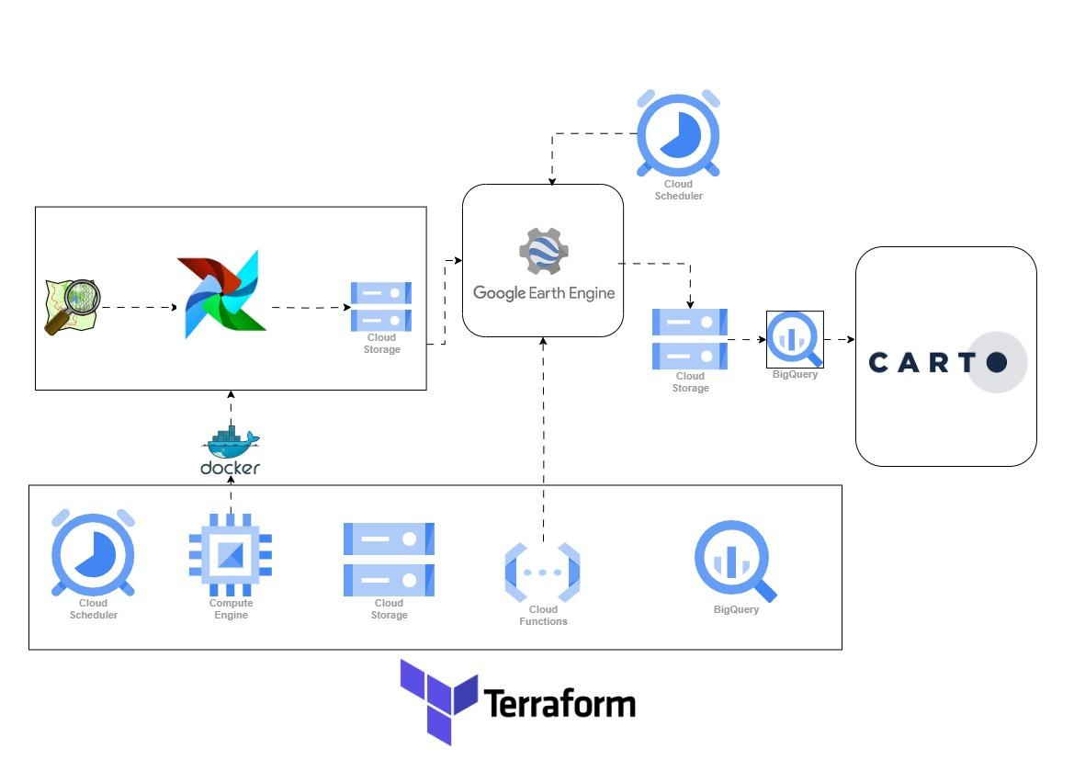
How It Flows on Google Cloud
AI next step
Vertex AI for yield and stress prediction · Gemini agent to ask "which farms are stressed?"

Slide 5


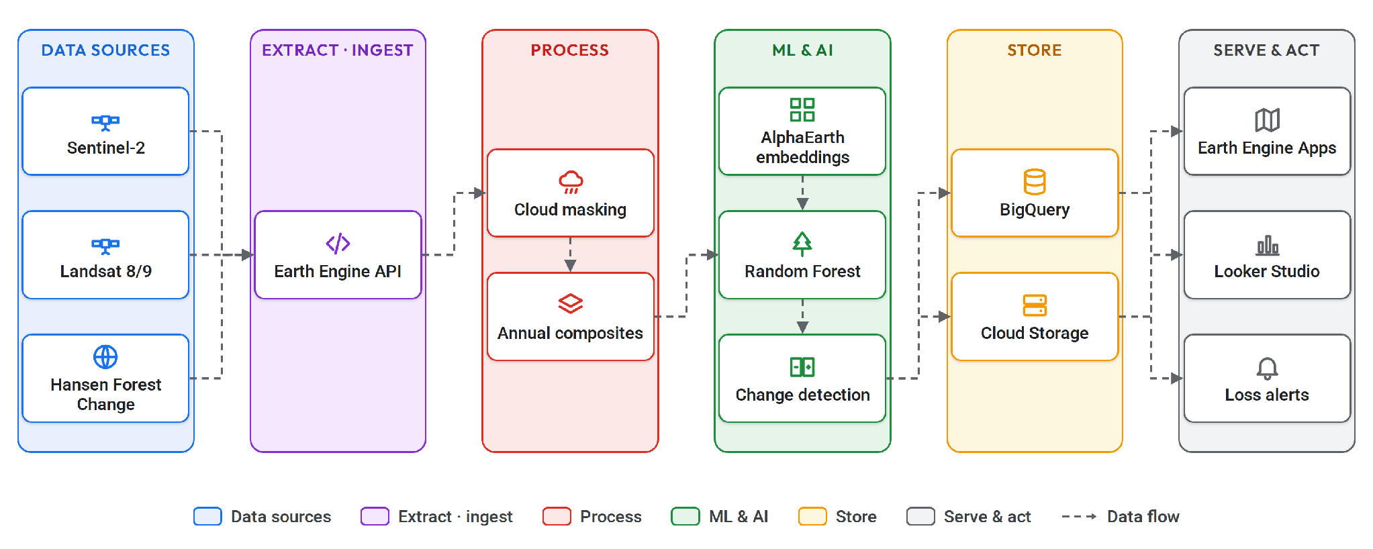
Watching Forests from Space
USE CASE 01 · FORESTS
Unilever · NGIS
Nigeria Forest Watch
Notes:
The problem: forest loss is fast, remote and hard to verify on the ground, and EU buyers now demand proof that cocoa, palm, soy and coffee are deforestation-free (EUDR). Walk the flow: 1 Input — Sentinel-2, Landsat and the Hansen Global Forest Change baseline. 2 Process — Earth Engine masks clouds and builds a cloud-free composite for each year. 3 Classify — forest vs non-forest with a Random Forest; AlphaEarth embeddings mean you need far fewer labels; Vertex AI if you need a custom model. 4 Detect — difference the years to find loss and raise alerts. 5 Serve — publish as an Earth Engine App, push stats to BigQuery, dashboard in Looker Studio. Who uses it: Unilever with NGIS traced palm-oil supply chains on Earth Engine, BigQuery and Analytics Hub — it became TraceMark. My build: Nigeria Forest Watch, a live Earth Engine app — open it now.

Slide 6
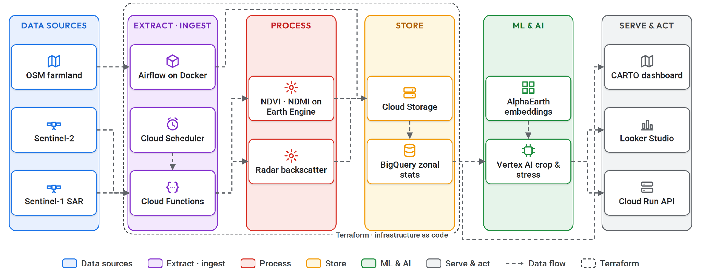
Monitoring Farms at Field Scale
USE CASE 02 · AGRICULTURE
MapBiomas · UN FAO
FarmWatch
Notes:
The problem: smallholder fields are small, often cloudy and rarely labelled, so crop maps and stress signals arrive late, if at all. Walk the flow: 1 Input — OpenStreetMap field boundaries, Sentinel-2 optical and Sentinel-1 radar, which sees through rainy-season cloud. 2 Ingest — Airflow cleans the field data, Cloud Functions pull new imagery on a schedule, everything lands in Cloud Storage. 3 Features — NDVI and NDMI time series, radar backscatter, and AlphaEarth embeddings so a few hundred labels are enough. 4 Model — join everything per field in BigQuery, then train crop-type or stress models with BigQuery ML or Vertex AI. 5 Serve — CARTO or Looker Studio dashboards, or an API on Cloud Run. Who uses it: MapBiomas uses the Satellite Embedding dataset to map agricultural change across Brazil; FAO is among the early testers. My build: FarmWatch — the architecture on slide 4.

Slide 7
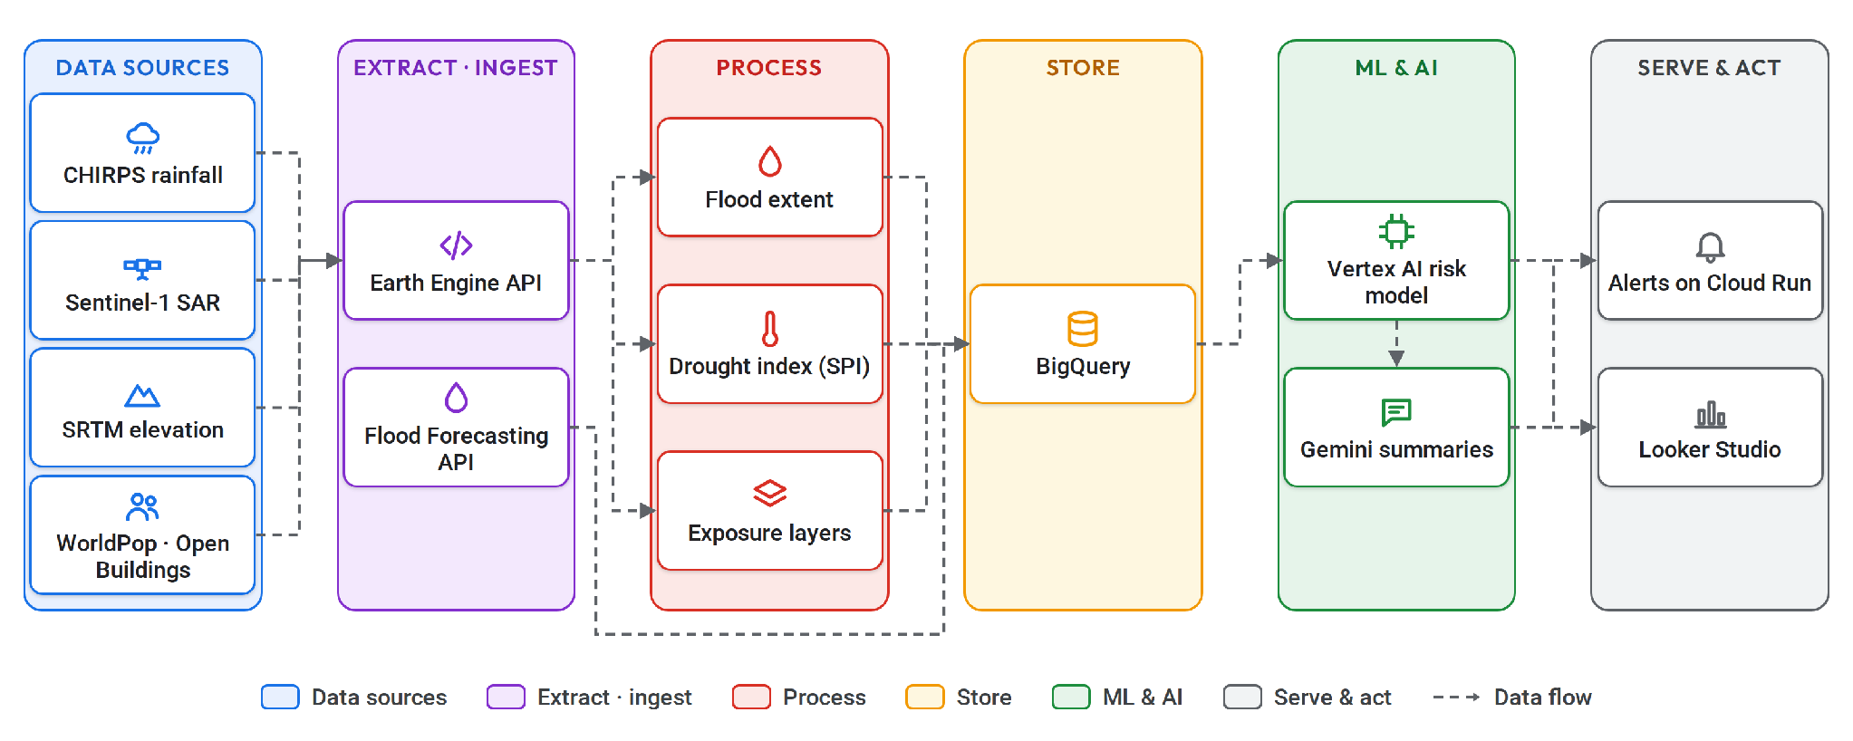
Seeing Floods and Droughts Coming
USE CASE 03 · CLIMATE RISK
Flood Hub · GiveDirectly · Vantor
Land-use change & drought study
Notes:
The problem: floods and droughts hit the same communities year after year, and warnings often arrive too late to act on. Walk the flow: 1 Hazard data — CHIRPS daily rainfall, Sentinel-1 radar for flood water through cloud, JRC Global Surface Water for 40 years of water history, SRTM elevation for low-lying areas. 2 Process — Earth Engine maps flood extent and computes a drought index like SPI. 3 Exposure — who and what is in harm's way: WorldPop, Open Buildings, land-cover change. 4 Risk model — combine hazard and exposure per LGA in BigQuery, train with Vertex AI, and pull Google's river forecasts from the Flood Forecasting API. 5 Act — send alerts from Cloud Run, let Gemini write plain-language summaries, dashboard in Looker Studio. Who uses it: Flood Hub forecasts riverine floods up to 7 days ahead for 700 million people in 100 countries, Nigeria included. GiveDirectly sends cash before floods; Vantor flags washed-out roads after storms. My build: my land-use change and drought study, plus multi-hazard climate risk modelling. Open Flood Hub and zoom to Lokoja.

Slide 8
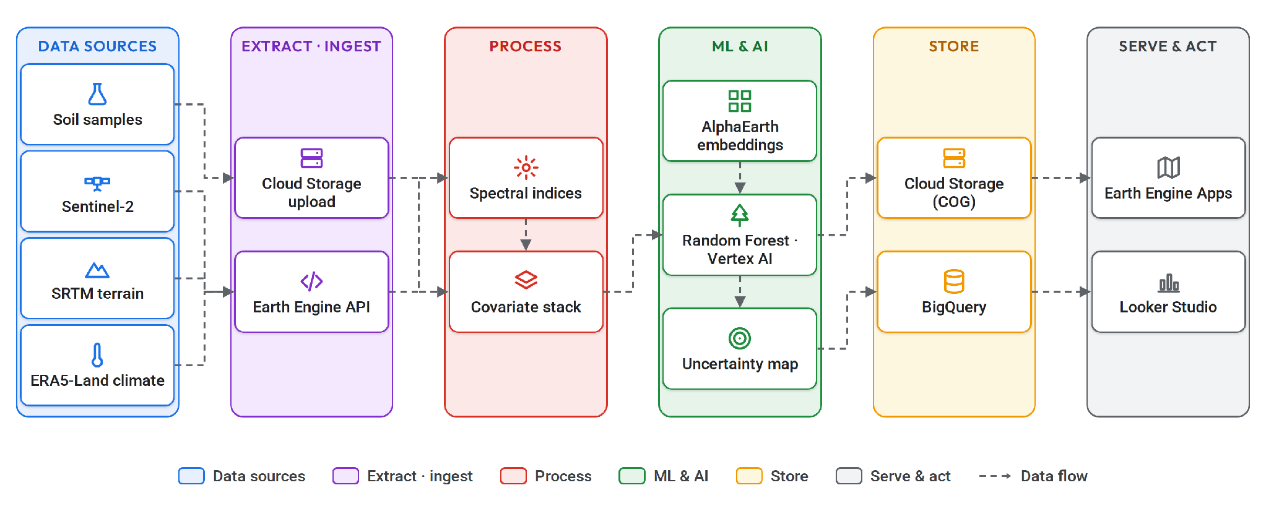
Mapping Carbon Under Our Feet
USE CASE 04 · SOIL & ECOSYSTEMS
Global Ecosystems Atlas
Soil carbon, Mato Grosso
Notes:
The problem: carbon markets and soil-health programmes need field-scale soil carbon maps, but lab samples are few and expensive. Walk the flow: 1 Input — a few hundred soil samples, Sentinel-2, SRTM terrain and ERA5-Land climate. 2 Covariates — stack them in Earth Engine with spectral indices; AlphaEarth embeddings add a strong ready-made feature. 3 Train — a Random Forest style regression, scaled with BigQuery ML or Vertex AI. 4 Predict — a wall-to-wall carbon map and, just as important, an uncertainty map. 5 Serve — Cloud-Optimized GeoTIFFs in Cloud Storage, an Earth Engine App or a Looker Studio dashboard. Who uses it: Global Ecosystems Atlas uses the Satellite Embedding dataset to help countries classify unmapped ecosystems; Harvard Forest and Stanford are testing it too. My build: soil organic carbon prediction for Mato Grosso, Brazil, published in Discover Sustainability (2024). The same workflow is what carbon-credit and regenerative agriculture programmes need in Africa.

Slide 9
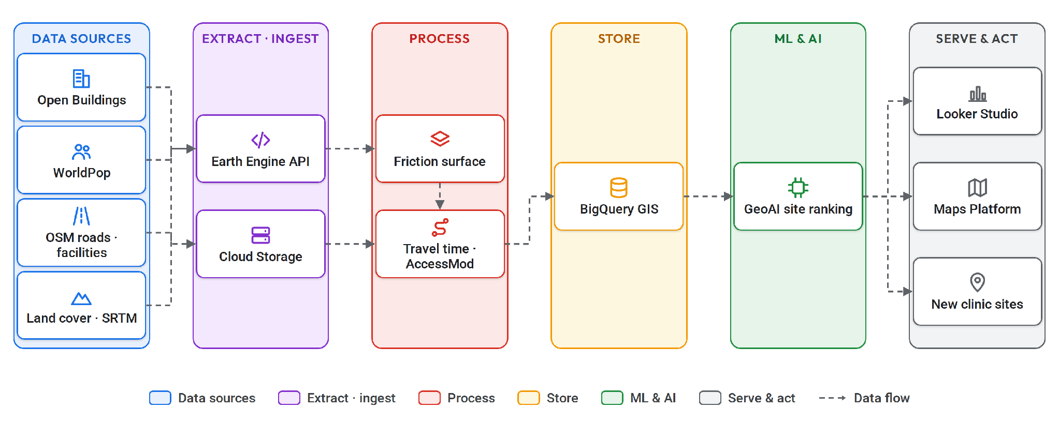
Finding Who the Clinic Can't Reach
USE CASE 05 · HEALTH ACCESS
WorldPop · AFENET · Sand Tech
Malaria drug access, Kogi
Notes:
The problem: a clinic that looks close on a map can be hours away on foot. Planners need to know who is actually out of reach. Walk the flow: 1 Input — Open Buildings (over 1.8 billion structures, so we know where people live even in unmapped settlements), OSM roads, health facility points and WorldPop. 2 Friction — how fast you can move across each pixel, from land cover, slope and a travel-speed table. 3 Travel time — Earth Engine's cumulativeCost or AccessMod turns friction into minutes to the nearest facility. 4 Analyse — in BigQuery GIS, count the people beyond 30 or 60 minutes. 5 Act — dashboard in Looker Studio, map it with Maps Platform, and pick sites for new clinics or outreach points. Who uses it: WorldPop and AFENET Nigeria overlaid Open Buildings with clinics and travel-time models to find settlements missed by vaccination; Sand Technologies built Rwanda's healthcare planning tool on the same data. My build: access to antimalarial (ACT) distribution points in Kogi State, using AccessMod and GeoAI.

Slide 10
Google Earth Is Becoming an Intelligence Layer
WHAT'S NEW · ALPHAEARTH & GOOGLE EARTH AI
Geospatial Reasoning
Ask Google Earth
Gemini agent across Earth Engine, BigQuery and Data Commons
Plain-language questions turned into analysis with Gemini
Earth AI in BigQuery
Population, Solar, Environment, Roads and Street View insights
AlphaEarth Foundations
24%
16×
A "virtual satellite": 64 numbers for every 10 m of land, every year
lower error
more compact
Notes:
Start with AlphaEarth Foundations from Google DeepMind (July 2025): one AI model fuses optical, radar, LiDAR, climate and more into a 64-number summary of every 10 m square of land, every year. It had 24% lower error than the other models tested, strongest when labels are scarce, and is 16 times more compact, so global analysis is cheap. It's in Earth Engine as the Satellite Embedding dataset: ee.ImageCollection('GOOGLE/SATELLITE_EMBEDDING/V1/ANNUAL'). Used by FAO, MapBiomas, Global Ecosystems Atlas, Harvard Forest, Stanford and CARTO. For Nigeria, where labelled data is the bottleneck, this changes what one developer can build. Then Google Earth AI: Google Earth is no longer just a 3D globe. Foundation models for imagery, population and environment — Oxford used Population embeddings to lift a 12-month dengue forecast in Brazil from R² 0.46 to 0.66. The Geospatial Reasoning agent uses Gemini to plan multi-step analyses and scored 0.82 on Q&A benchmarks versus 0.50 for baseline Gemini 2.5 Pro. Ask Google Earth brings this to professionals in plain language, with new global 20/40 m contours and easy KML/GeoJSON import in 2026. At Next '26 the datasets landed directly in BigQuery — no ingestion pipeline. Partners include UN Global Pulse, GiveDirectly, Bellwether and CARTO.

Slide 11



How Green Is Abuja?
LIVE DEMO · EARTH ENGINE
START HERE
Code Editor
Data Catalog
Today's demo script
code.earthengine.google.com
developers.google.com/
earth-engine/datasets
https://shorturl.at/iovVM
MY EARTH ENGINE PROJECTS
Nigeria Forest Watch
Deforestation App (Amazon)
ee-adedoyinsamuel25.projects.earthengine.app/
view/nigeriaforestapp
ee-adedoyinsamuel25.projects.earthengine.app/
view/deforestation-app
FarmWatch pipeline
Soil carbon, Mato Grosso
github.com/SammyGIS/geospatial-de-pipeline
github.com/SammyGIS/matto-grosso-soc-prediction
Notes:
Before the talk: open the demo script in the Code Editor, run it once so tiles are cached, and have a backup screenshot of each map and chart in case the venue Wi-Fi fails. Open the two live apps in tabs too. Intro (1 min): open the Code Editor and tour it — scripts on the left, code in the middle, Inspector/Console/Tasks on the right, map below. Then open the Data Catalog, search "Sentinel-2" and "CHIRPS" to show that petabytes of free data are one line of code away. Demo (5 min), from today's script: 1 — Load the boundary: Abuja Municipal from FAO GAUL; show it on the map and the list of FCT area councils in the Console. 2 — Ten years of NDVI: toggle NDVI 2016 then 2025 — cloud-masked Landsat 8/9, nothing downloaded. 3 — Plot the mean and trend: the mean NDVI chart with its red linear trend line and R²; read out the printed slope and the change over the decade. Do not predict the numbers before you run it. 4 — Greening vs browning: turn on the per-pixel trend map (red = losing green), zoom to the growth corridors and ask the room to name the estates; then the green km² bars and the MODIS 16-day chart. Bonus: toggle the AlphaEarth embedding layer. Close with my projects: Nigeria Forest Watch and the Amazon deforestation app are live Earth Engine Apps; FarmWatch and the Mato Grosso soil carbon model are on GitHub. This one script is the seed of a monitoring app, a BigQuery analytics product, or a Gemini agent.

Slide 12
Thank You!
Let's build Nigeria's future from space.
sammygis.github.io | github.com/SammyGIS | LinkedIn: adedoyin-samuel-ajeyomi
Live app: Nigeria Forest Watch · Slides: [add link]
Notes:
Close: pixels are free, the tools are free to start, and the problems are right here — floods on the Niger and Benue, forests in Cross River, farms in Kano, clinics in Kogi. Invite questions and connections.

